Slide 1
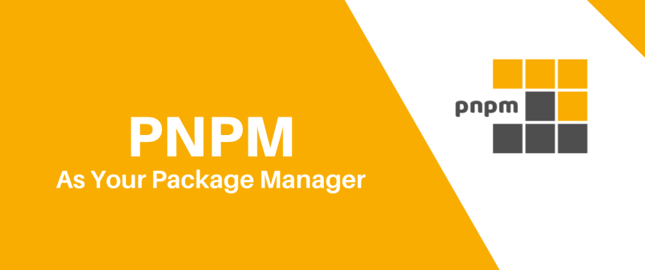

Slide 2
What is PNPM? 😐
What is Nodejs💀
PNPM is a nodejs package manager.
It is Fast, disk space efficient package manager
pnpm is up to 2x faster than npm.
Nodejs allows you to run JavaScript on the server.
It has various package managers to help you install modules(libraries you use during development). Packages include
Pnpm
Yarn
Npm
What is NPM? 😊
NPM is a native(default) package manager for Nodejs packages.
is installed on your computer when you install Nodejs.

Slide 3
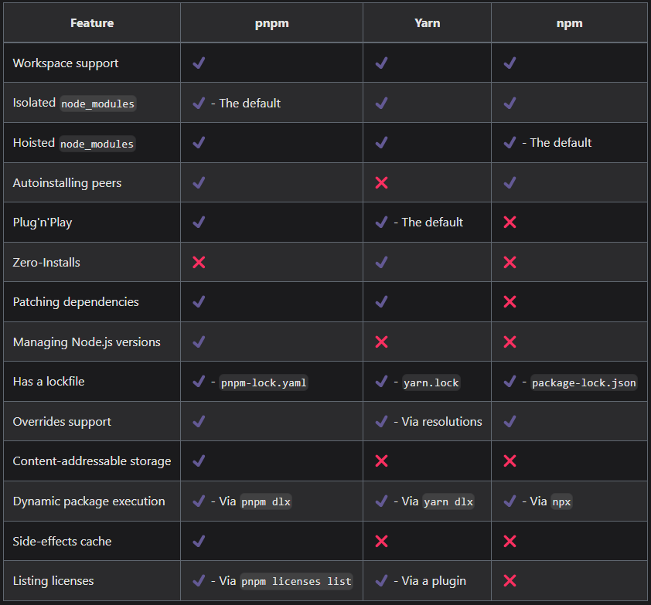
Feature Comparison

Slide 4
PNPM Installation(https://pnpm.io/installation)
On Windows
Using PowerShell: iwr https://get.pnpm.io/install.ps1 -useb | iex
On Windows
Confirm Installation: pnpm --version
Let’s install Nodejs(https://pnpm.io/cli/env)
Pnpm env use - install and set the version to be the current version to use.
Long Term Support(LTS) version of Nodejs: pnpm env use --global lts
The latest version of Nodejs: pnpm env use --global latest
Install a specific version of Nodejs: pnpm env use --global 16
Pnpm env add - Installs a specified version(s) of Node.js without activating them as the current version
Add node 18 and 20: pnpm env add --global 18 20.0.1
Pnpm env remove - Removes the specified version(s) of Node.JS.
Remove node 18 and 20: pnpm env remove --global 18 20.0.1
Pnpm env list - List Node.js versions available locally or remotely.
Print locally installed versions: pnpm env list
Print remotely available Node.js versions: pnpm env list --remote

Slide 5
